Slide 1
ETC5543 - Internship Project
FORECASTING DEMAND FOR NATIONAL RESEARCH SUPERCOMPUTING
AUSTRALIAN ACADEMY OF SCIENCE
YUSUF KURNIA ROMADHON

Slide 2
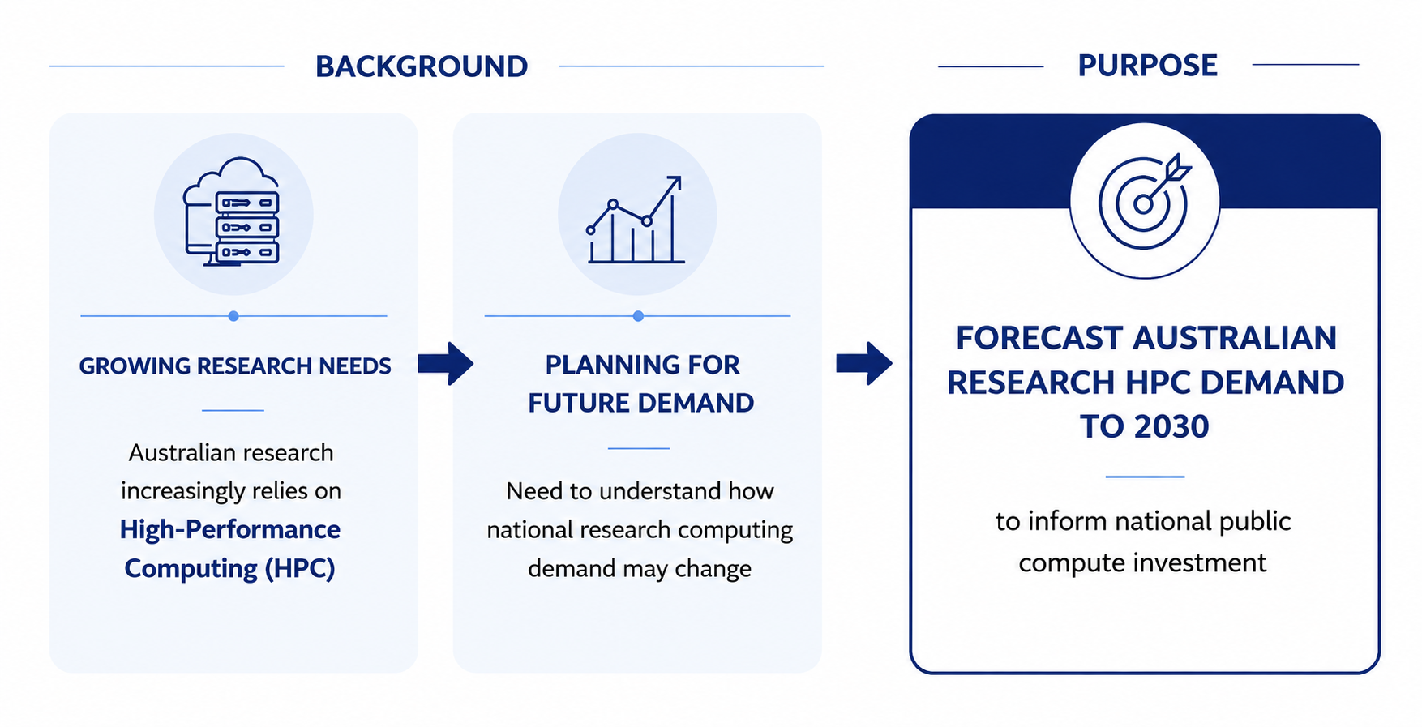
Project Background and Purpose

Slide 3
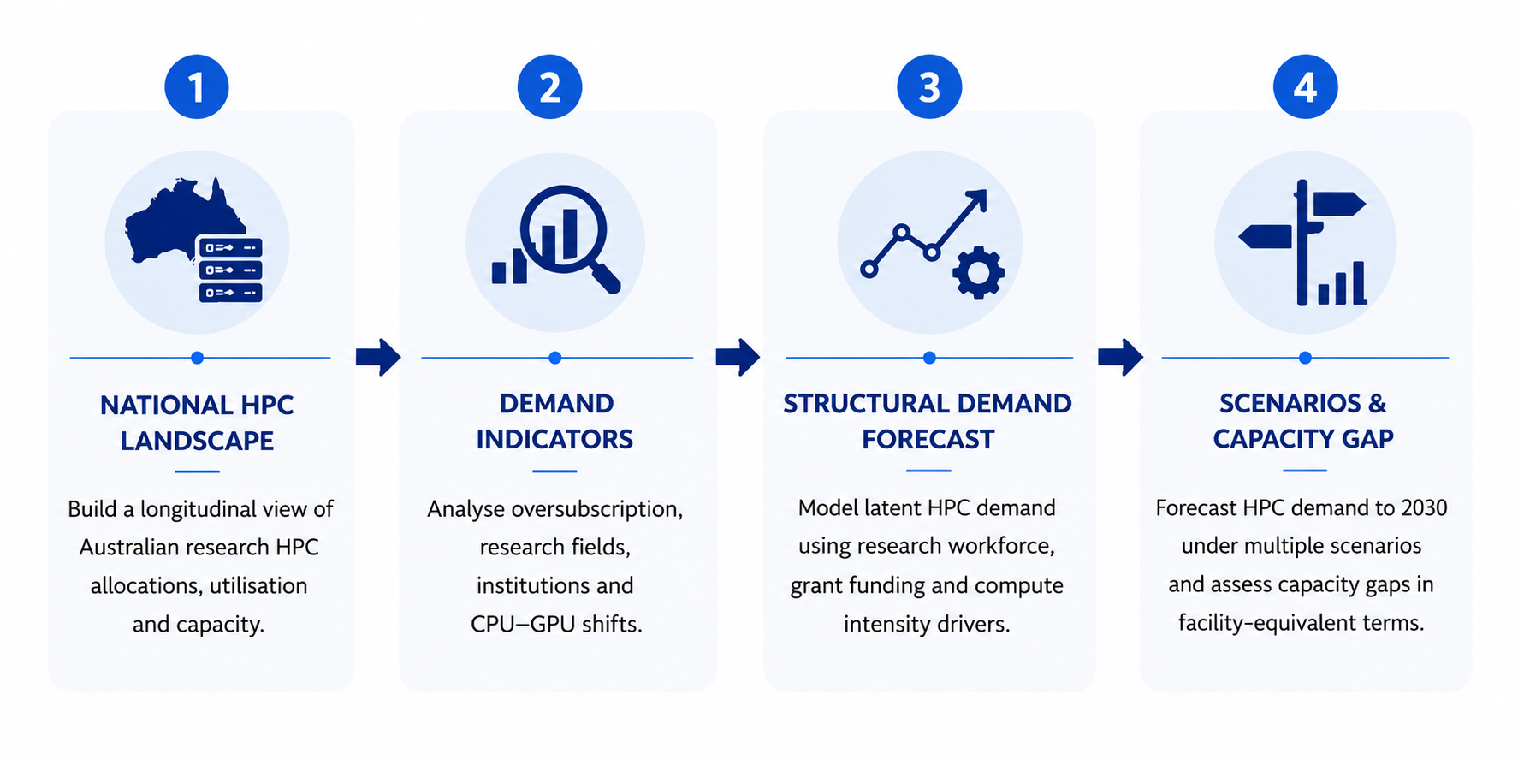
Project Scope

Slide 4
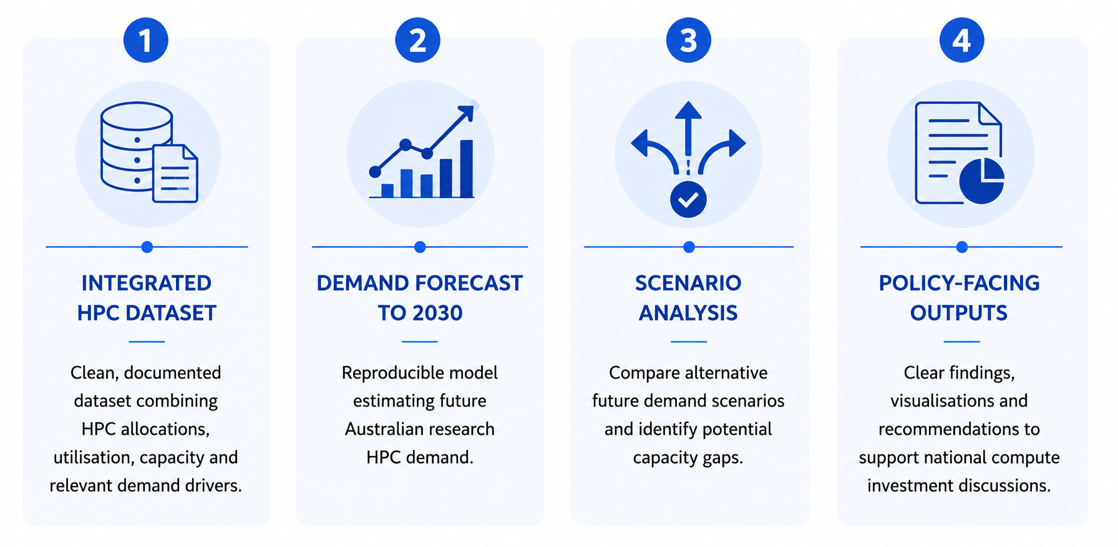
Project Deliverables

Slide 5
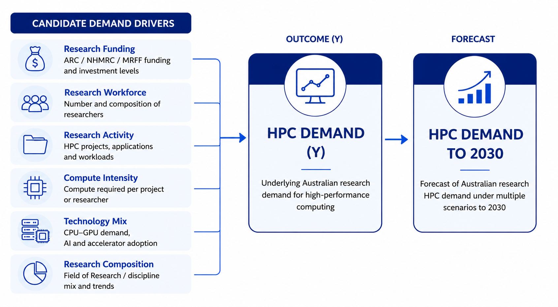
Analytical Framework

Slide 6
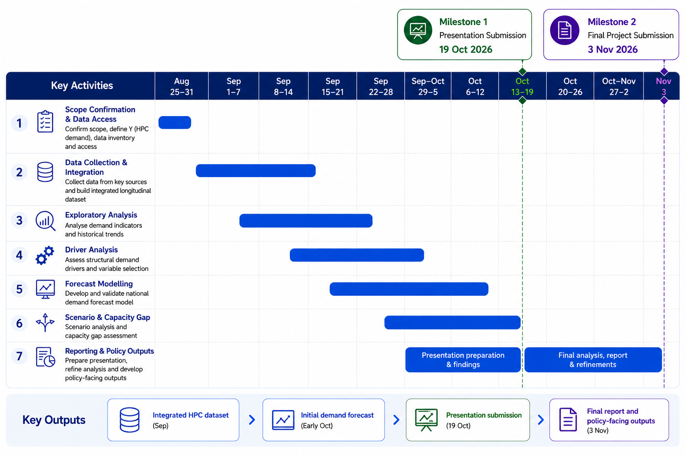
Project Timeline

Slide 7
THANK YOU

